Slide 1
IMPLEMENTATION OF A 5G TESTBED WITH O-RAN AND SOFTWARE-DEFINED RADIOS
Chris Escandor
Samuel Canthro
William Bigley
Edward Keith
Kat Milicevic

Slide 2
agenda
Scope
Requirements
Schedule
Project Methodology
Cost
Skills Analysis
Risks

Slide 3
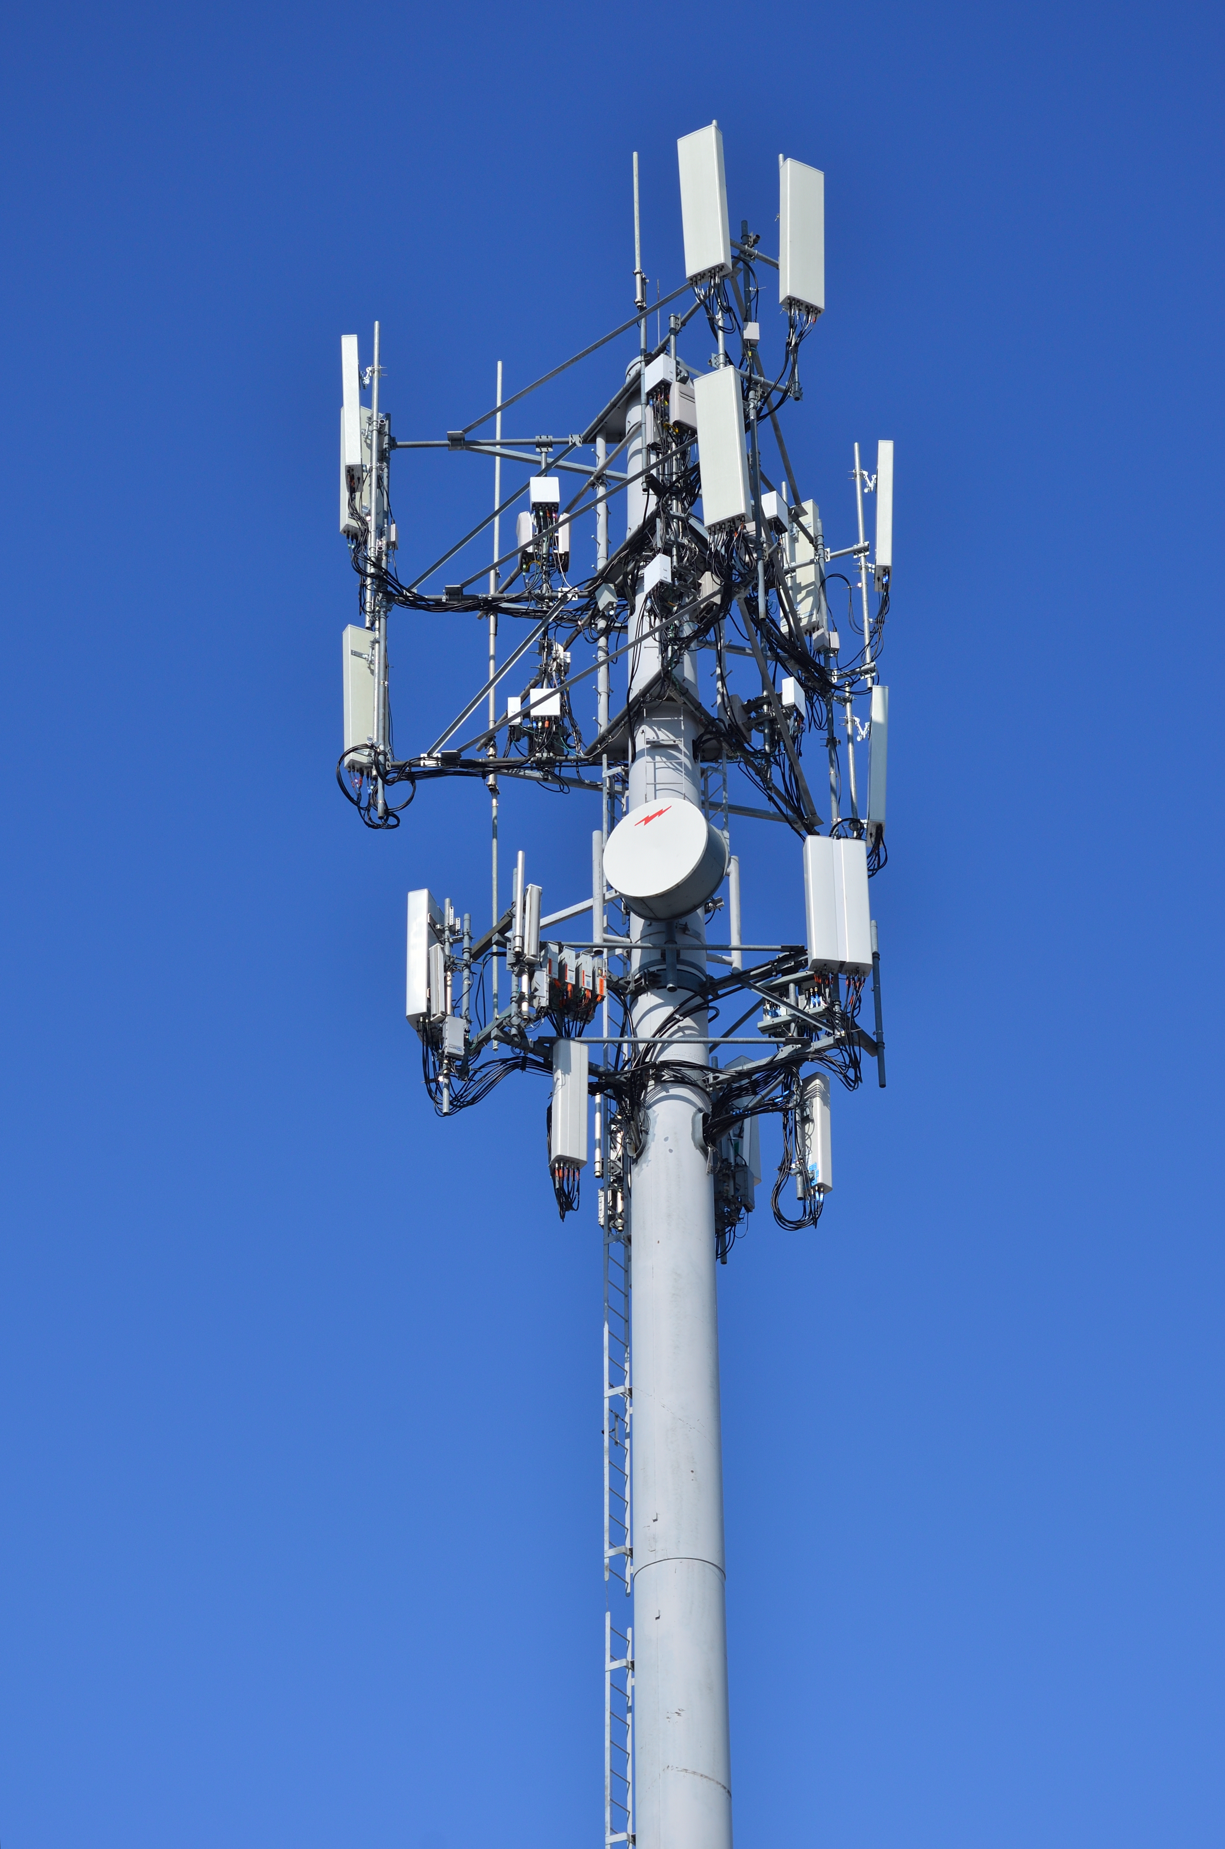
Project scope and objectives
Develop 5G indoor testbed with open-source software-defined radios and following O-RAN standards
Aim to overcome LTE vendor lock-in and demonstrate feasibility of the project
Increasing accessibility of this technology, encouraging interoperability and innovation

Slide 4
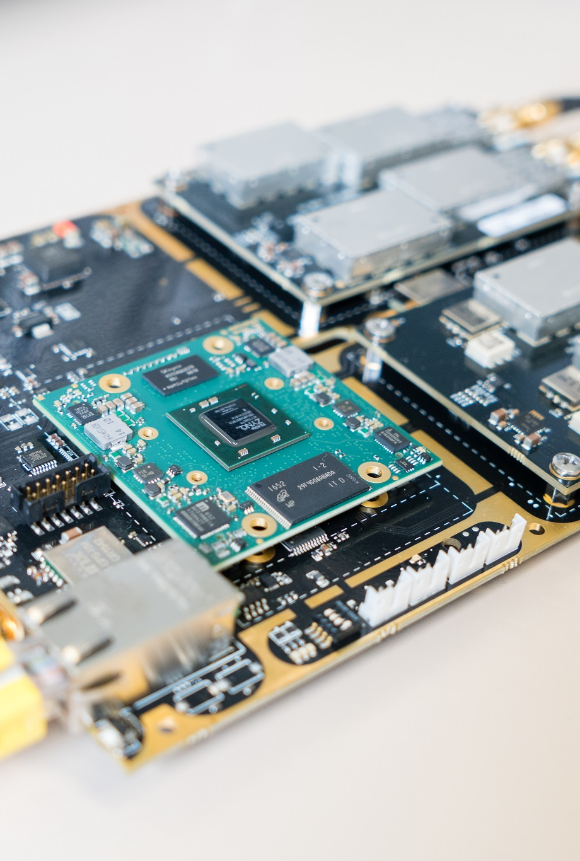
requirements
Implementing 5G base system and demonstrating communication between two connected devices
Technical requirements:
National Instruments B-205mini SDR module
srsRAN software
Computer system running Ubuntu 22.04 and meeting hardware requirements
Deliverables
Docker image of testbed for ease of distribution and replication
User guide
Fully implemented testbed
Nonfunctional requirements:
Performance
Reliability
Security

Slide 5
Project schedule
Sprint 1: Weeks 1 – 4 : Upskilling and research
Sprint 2: Weeks 5 – 6: Startup; initial configuration
Sprint 3: Weeks 7 – 8: System & Architecture Design
Sprint 4: Weeks 9 – 10: Hardware Configuration
Sprint 5: Weeks 11- 12 : Planning of Documentation & User Guide
Winter Holiday Break
Sprint 6: Weeks 13 – 14: Software Installation & Setup
Sprint 7: Weeks 15 – 16: First round of testing and integration
Sprint 8: Weeks 17 – 18: Network Configuration
Sprint 9: Weeks 19 – 20: Functional Testing and Validation
Sprint 10: Weeks 21 – 22: Performance Evaluation and Optimisation
Sprint 11: Weeks 23 – 24: Documentation Finalisation and Client Approval

Slide 6
Project Methodology
Chosen project management methodology is secSDLC
Phases include:
Initiation: identifying scope and holding kick-off meetings, including security considerations
Planning/Analysis: identifying functional requirements to be fulfilled by the network and defining relevant security procedures
Development – Logical design: determining plan for design of system, including risk mitigation strategies
Development – Physical design: designing physical network topology, prioritising security concerns
Implementation/Deployment: implementing network infrastructure and security controls, following secure deployment practices, and putting together documentation

Slide 7

Cost estimate
Project Management | Hours | Cost p/h | Total (incl. GST)
Project Manager | 360 | 350.00 | 144,900.00
Team Members | 1440 | 120.00 | 198,720.00
Mentor | 26 | 142.00 | 4,245.80
Total Cost |  |  | 347,865.80
Hardware | Item Qty | Cost Per | Total (incl. GST)
Ettus Research B205mini SDR Kit + Antennae | 1 | 2,943.76 | 3385.17
Computer System incl. Monitor | 1 | 774.00 | 860.20
Total |  |  | 4,245.37

Slide 8
Skills analysis
Familiarity with O-RAN Architecture
Protocols and interfaces, functions of each element of the architecture
Knowledge of 4G/5G/LTE technologies and standards
Deployment scenarios, functional splits, core network protocols
Understanding of network protocols and networking concepts
OSI Protocol Suite
Expertise in operating systems and containerisation technologies
Linux (Ubuntu), Docker, different configuration of host and guest operating systems
Soft skills
Documentation abilities, technical writing skills, collaboration, and teamwork

Slide 9

Risk / issue management
Development of a risk register and accompanying mitigation plan is crucial
Risk management plan
Identification and analysis of risks
Mitigation strategies
Risk response plan
Measure of consequence/likelihood – assigned to each identified risk for analysis purposes
Overall risk classification
Issue Management
Identification and Analysis
Resolution plan

